Slide 1


Shaping India's Green Energy Transforming the Unorganized Biomass Densification Industry into a Data and IoT-Driven Manufacturing Solutions for Maximum Optimization. Integrated Plant Manufacturing Process, visibility, Automation Solutions (Briquettes & Pellets), Torrefaction, Green Steam, Green Energy & Biomass Pellet Manufacturing.

Slide 2
Pioneering Biomass Densification Operations & Maintenance: A First in India!
We are proud to be the first Indian company to revolutionize the biomass densification industry with innovative solutions like:
Operations & Maintenance for densification units, including spares & skilled manpower.
Leasing of Densification Machinery, reducing the burden of heavy CAPEX investment.
Professional Plant Operations, ensuring compliance with all government norms.
We are not just operating Equipment—we are transforming the industry with smart, scalable, and cost-effective solutions.

Slide 3
About Renovo Bio Solutions
Renovo Bio Solutions (RBS) Private Limited is a pioneering company at the forefront of green energy and pellet manufacturing, specializing in the most technically complex fuel processing, including Paddy Straw Bales and Cane Trash for biomass Briquette & pellet production.
RBS is India’s First Company Dedicated to Operations & Maintenance (O&M) in Biomass Densification (Briquettes & Pellets)
Data-Driven Automation & Real-Time Monitoring
Pioneer in Structured Monthly Production Models with Accountability.
End-to-End O&M Solutions to Optimize Efficiency & Reduce Downtime.
Innovative Approach to Enhance Productivity & Sustainability in Biomass Processing.
We believe in transforming the Biomass Densification Industry with Cutting-Edge Technology & Expertise!

Slide 4

Our Mission
To be India's first and most trusted organized player in Operations & Maintenance (O&M) for biomass densification (briquettes & pellets) and green energy projects, setting new benchmarks in efficiency, automation, and reliability.
We aim to revive and revolutionize the unorganized biomass industry by integrating automation, skilled manpower, and cutting-edge technology, ensuring higher production, sustainability, and industry compliance.

Slide 5

Our Vision
Optimize & Standardize the O&M of densification plants with automation-driven efficiency.
Develop & Deploy highly skilled professional manpower for the biomass industry.
Integrate Real-Time Monitoring with customized software solutions for enhanced productivity.
Introduce India’s First Leasing Model for briquette & pellet production machinery, reducing CAPEX burdens.
Revive & Scale struggling briquette & pellet plants with structured management & reliability.
We are committed to building a sustainable biomass ecosystem with data-driven decision-making, skilled workforce development, and innovative financial models—paving the way for a cleaner and greener future!

Slide 6
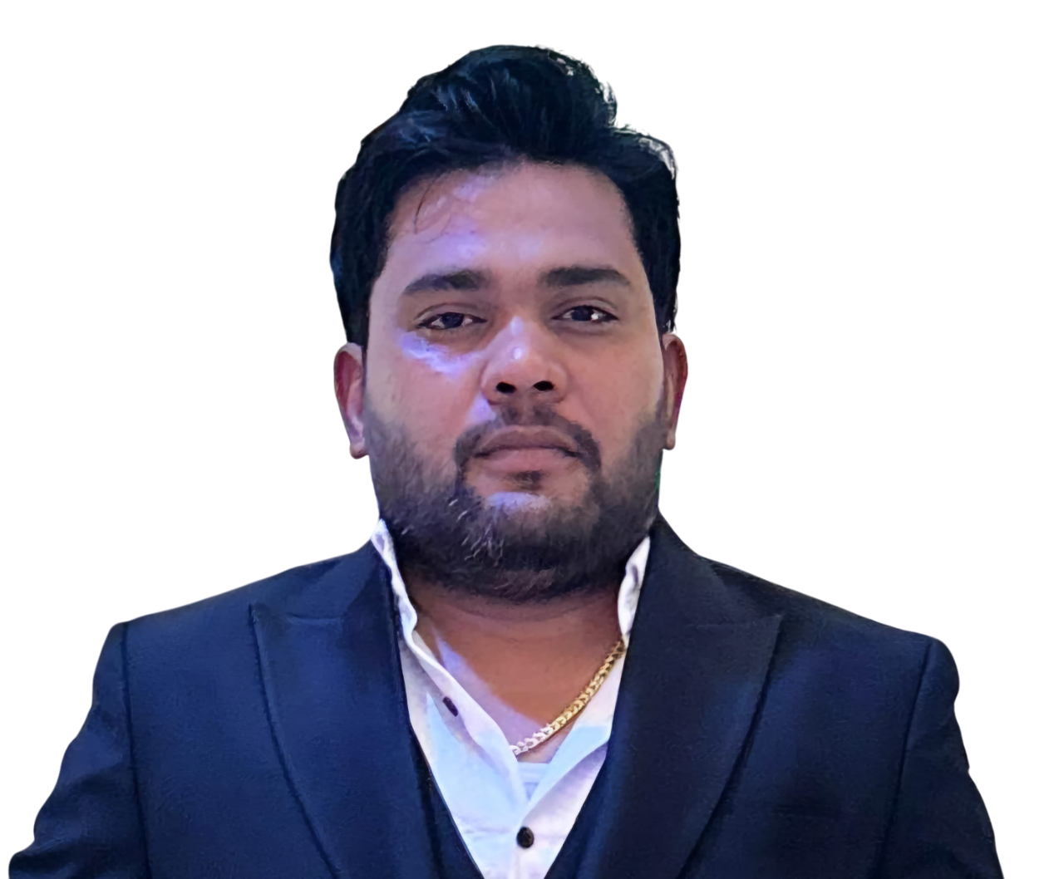
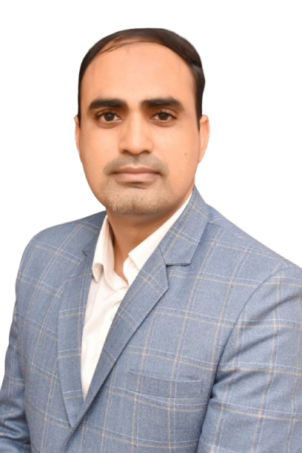
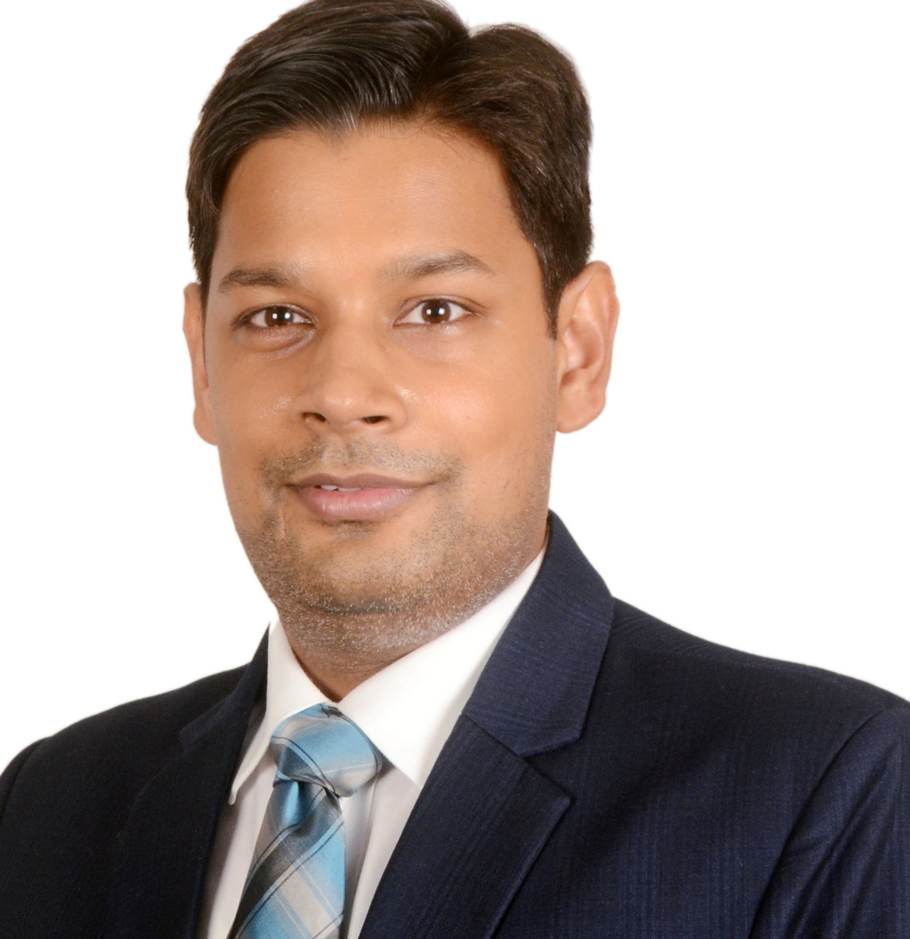
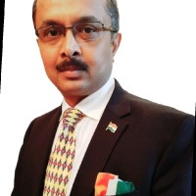
Our Team
Mr. Amrit Khater
Director
Mr. Manish Choudhary
Operations Expert
Col. Rohit Dev
Additional Director
Mr. Sunil Rai
Subject Expert
Amrit Khater has 15+ years of experience in the Bio-Energy sector, specializing in Biomass Processing Solutions. A second-generation entrepreneur and an alumnus of IIM, Bangalore, he pioneered in developing India’s first fully integrated Automated Fuel Processing Systems. With expertise in briquette/pellet machines and waste-to-fuel technologies, Amrit has worked with leading corporates to provide Techno-Commercially Viable Solutions for crucial issues like Paddy Straw crop burning.
With over 10 years of experience, Manish specializes in the Industrial Automation, optimizing efficiency, and ensuring seamless execution of business operations. His strong background in Biomass Processing, Densification, and Supply Chain Management enables him to oversee cross-functional teams, drive operational excellence, and implement strategies that enhance productivity.
A distinguished thought leader and domain expert in the fields of Bio-Energy, Geopolitics, and Security, Col. Rohit has an illustrious career spanning the Indian Armed Forces and the renewable energy sector. Currently serving as the Co-Chairperson of the Biomass Global Associates Forum and Expert Adviser to leading Bio-Energy organizations, Col. Rohit plays a pivotal role in policy advocacy for the GoI, leadership discussions, and global energy transition dialogues.
A renowned expert with 15+ years of experience in decarbonization, boiler transition from fossil fuels to Green Fuels, Biomass (Agro-Residue) Aggregation, effective storage, year-round biomass availability, supply chain management, and sustainability. He recently expanded his expertise by completing an Executive MBA from IIM Lucknow

Slide 7
RBS’ Key Strengths
Proven Expertise
Successfully managing 8+ active sites in biomass densification (briquettes & pellets).
Advanced Monitoring
Real-time audits, 24x7 online monitoring, and efficient asset deployment for operational excellence.
Industry Leadership
The CEO of Hi Tech Agro Energy is one of the Co-Founders & Promoters of RBS, bringing 40+ years of expertise in biomass densification.

Slide 8
Technological Integration
IoT & AI-Powered Remote Monitoring – Real-time insights for seamless operations.
Data-Driven Decision Making – Optimizing plant efficiency through analytics.
Advanced Automation & Predictive Maintenance – Minimizing downtime and maximizing productivity.
Spare Consumption Pattern Analysis – Tracking spare part lifecycle for optimized usage.
Material Enhancement for Reduced Spare Consumption – Adapting spare part material based on agricultural residue properties (e.g., higher silica in paddy straw vs. lower silica in corn cobs) to improve durability and reduce costs.

Slide 9
Our Core Services
Comprehensive O&M – Ensuring seamless equipment maintenance and regulatory compliance.
Technical Audits – Conducting plant performance assessments and ensuring safety standards.
IoT-Enabled Remote Monitoring – AI-powered dashboards for real-time project tracking.
Asset Deployment & Raw Material Sourcing – Efficient resource allocation for uninterrupted operations.

Slide 10
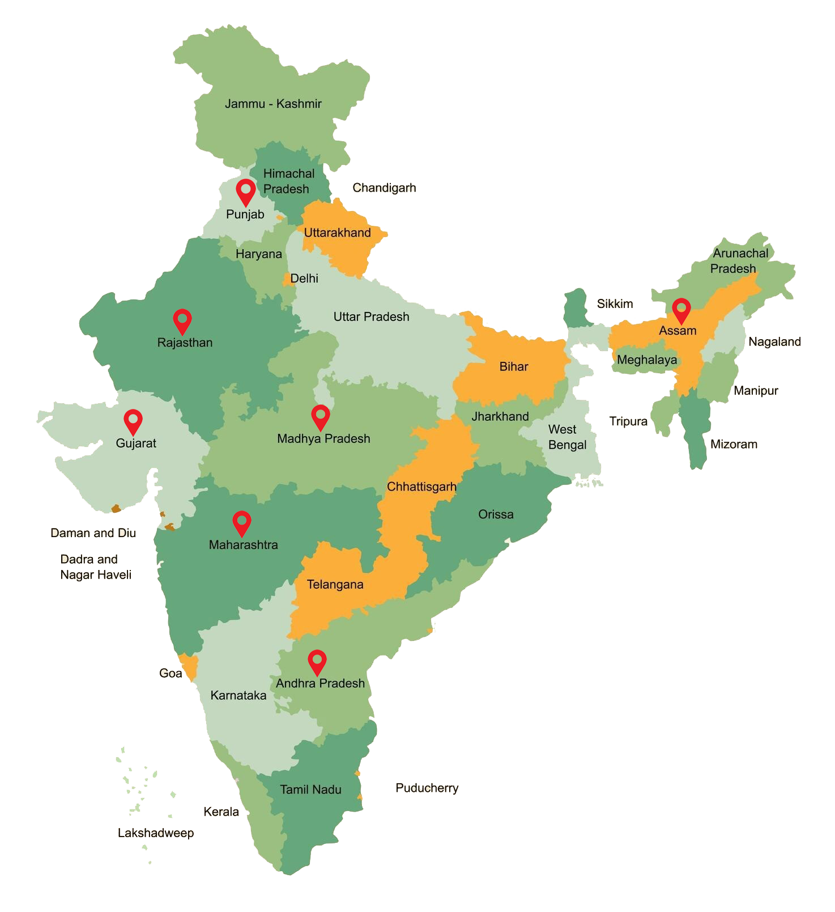
Current Key Projects
Nationwide Operations and Maintenance (O&M) Services
At Renovo Bio Solutions, we pride ourselves on offering comprehensive and reliable Operations and Maintenance (O&M) services across India. With a commitment to excellence and an unwavering focus on quality, our team delivers end-to-end solutions designed to ensure the seamless functioning of your assets, facilities, and infrastructure.
We understand the importance of operational efficiency and maintaining assets at peak performance. Our services are tailored to meet the unique demands of each client, ensuring minimal downtime and optimal operational output.

Slide 11
Achievements & Growth Plan
Current O&M Footprint
Managing 12 sites with a total capacity of 12,000+ Tonnes Per Month
2025-26 Goal
Expansion to 30 sites, achieving 30,000+ Tonnes Per Month capacity.
2028 Vision
Scaling to 50 sites with a massive 100,000+ Tonnes Per Month capacity.
Remote Monitoring
Targeting 100+ AI-powered subscriptions by 2025.

Slide 12
Why Choose Renovo Bio Solutions?
India’s First & Most Advanced Biomass Briquette and Pellet O&M Company
Pioneering Data-Driven Automation & Predictive Analytics
Committed to Clean Energy & Sustainable Solutions
Scalable & Technology-Backed Operations

Slide 13
Contact Us
Website: www.renovobiosolutions.com
Email: info@renovo.com
Phone: +91-9911198829
Address: 2nd floor, Plot No, 521, Sector 19, Pocket 1, Dwarka, New Delhi, Delhi, 110075
Social Media: [LinkedIn, Twitter, etc.]

